Slide 1
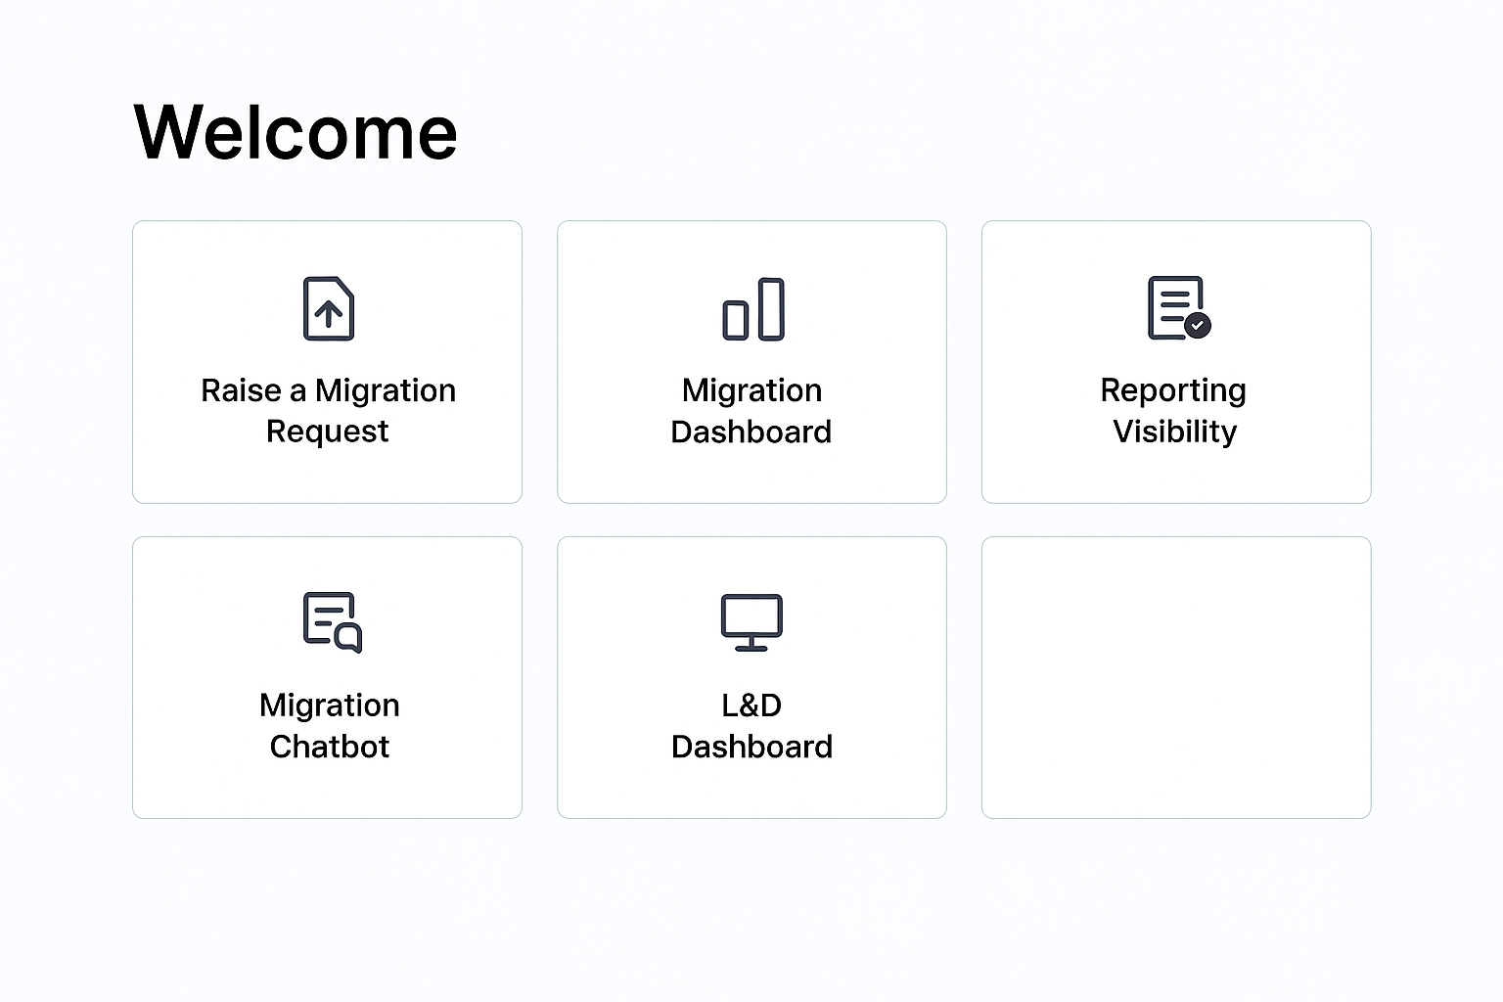
Landing Page
Raise a Migration Request
Migration Dashboard
Migration Chatbot
L&D Dashboard
Project Attributes Database

Slide 2
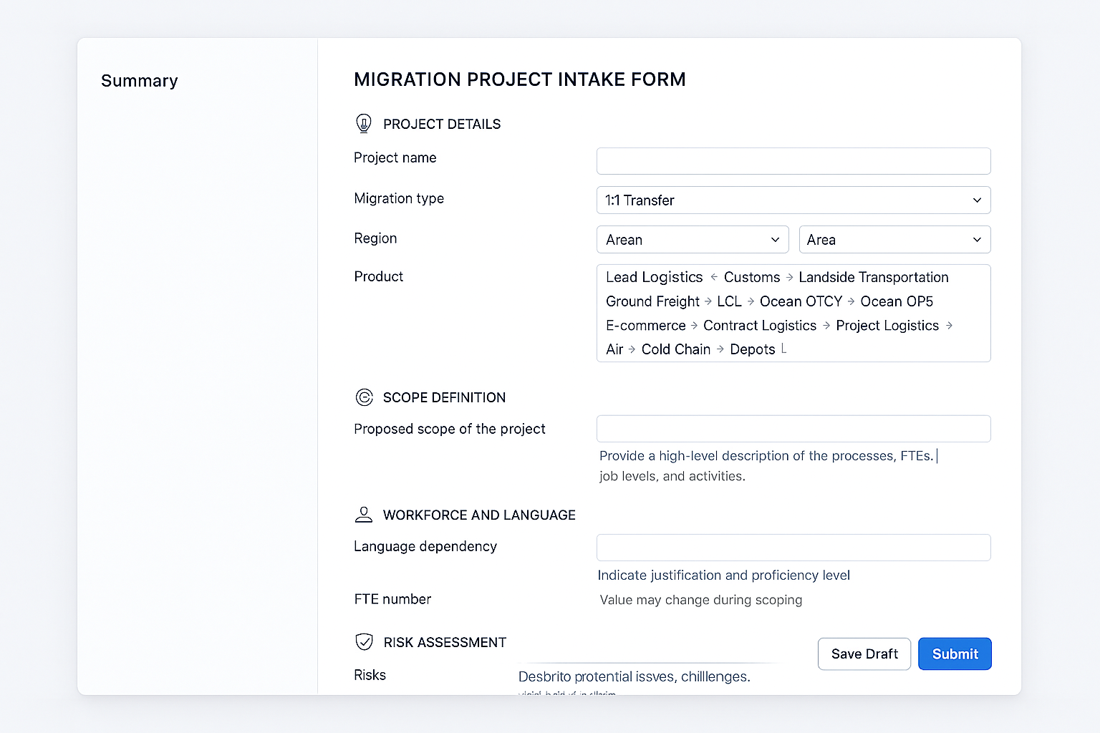
Raise a Migration Request
Detail Required input
Project name
Migration Type (Options: “1:1 Transfer”, “New/Additional work, tasks or activities”
Region
Area
Product (Lead Logistics, Customs, Landside Transportation, ground Freight, LCL, Ocean (OTCX), Ocean (OPS), E-commerce, Contract Logistics, Project Logistics, Air, Cold Chain, Depots, LTA, OTC, STP, ATR)
Function (AIR, OCE, HBDS,
Proposed Scope of the project: this is a high-level scope of the project something that states what are the processes that are being migrated, a general detail that speaks about the FTEs and Job Levels, the process they are doing, this is just something similar to a problem statement, it is a general description of what is meant to be migrated.
Language dependency – justification and level required.
FTE number: this figure might change later during the scoping exercise
Job Level split (how many JL2, Jl3, JL4)
(Optional) Risks, referring to the potential already identified risks of migration, what can go wrong basis on the know details, if there are challenges that are already expected, anything that needs to be considered for such.
Raise a Migration Request
User Inputs
Project Attributes Database

Slide 3
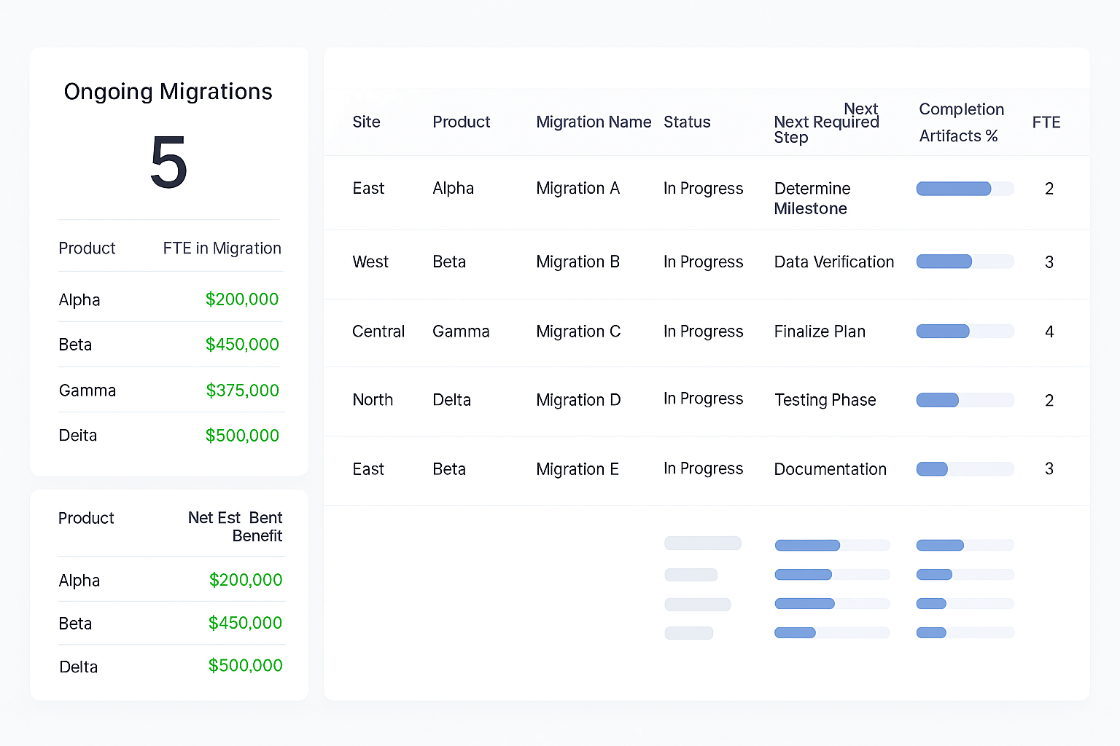
Migration Dashboard (1st overview)
Description A compact product summary panel that displays: Product name FTE currently assigned to each product in migration Net estimated cost benefit in dollars per product On the right side, include a detailed migration table with the following 8 columns: Site Product Migration name Status Next required step Completion artifacts percentage Completion timeline percentage FTE allocation
Migration Dashboard
Project Attributes Database

Slide 4
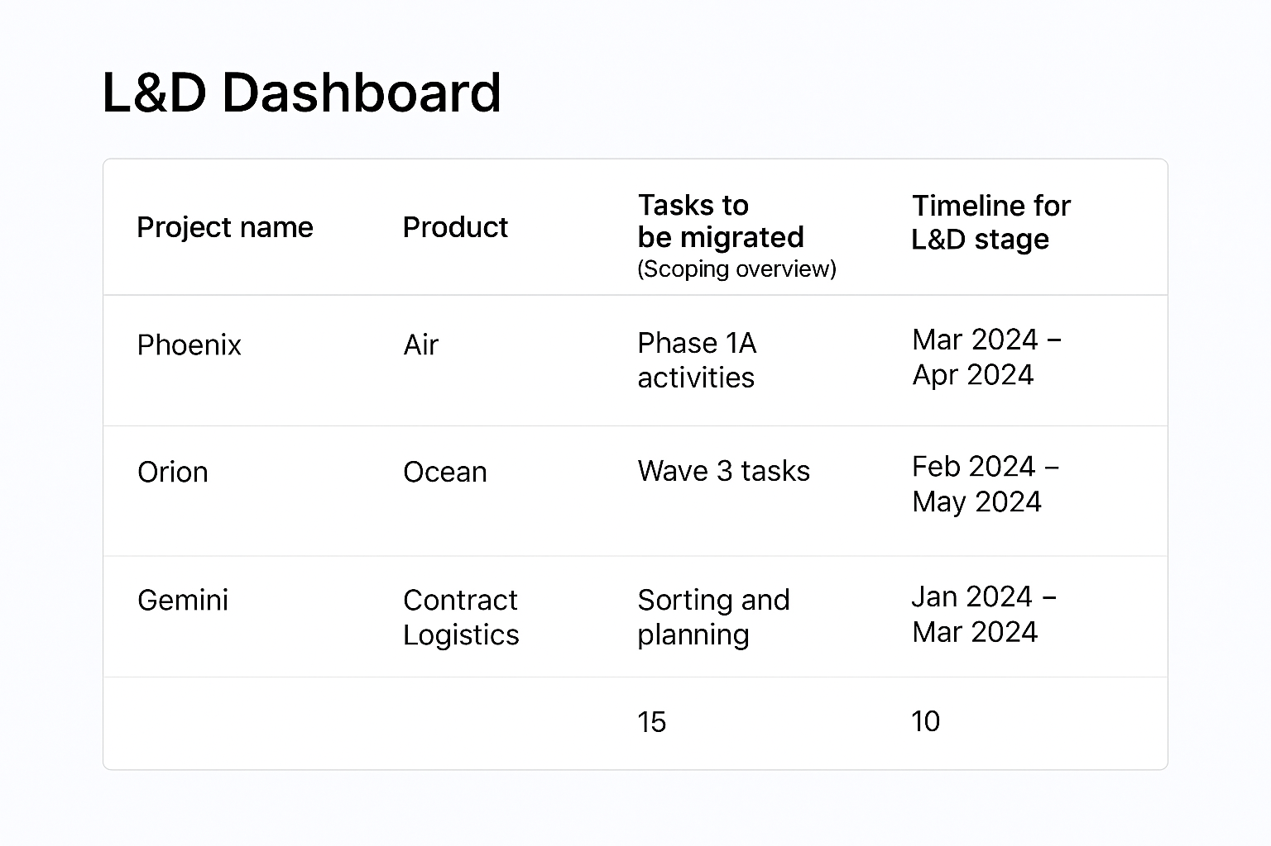
L&D Dashboard
Project name
Product
Tasks to be migrated (Scoping overview)
Timeline for L&D stage
FTE
Project Attributes Database

Slide 5
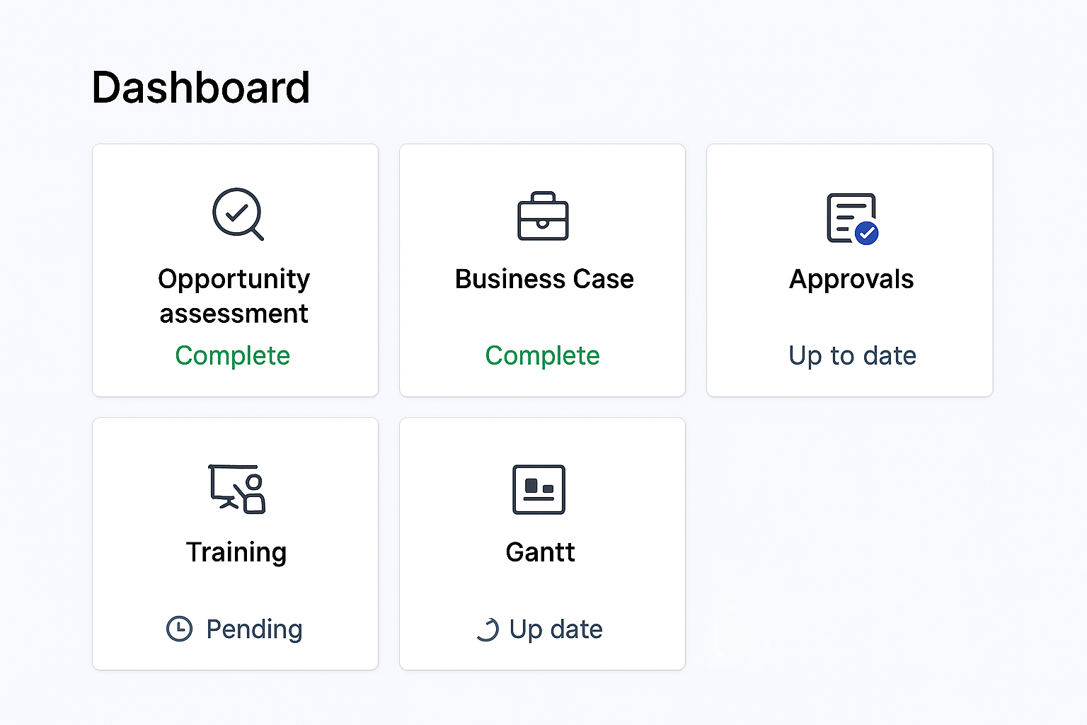
Individual Project Dashboard
Project Dashboard
Opportunity assessment
Business Case
Approvals
Gantt
Cost computation
This is fundamentally a dashboard. It contains the main milestones. Each item will open into their own screen with details for the project
Training
More…
Project Attributes Database

